Slide 1
FINANCING
YOUR COLLEGE
EDUCATION
Presented by
Katy Fitzgerald
Mission College Financial Aid & Outreach Supervisor
Foster & Homeless Student Liaison
Katy.Fitzgerald@missioncollege.edu

Slide 2
Types of Financial Aid – Federal
Pell Grant
up to $6,095 a year, lifetime eligibility of 6 yrs. f/t equivalent
Supplemental Educational Opportunity Grant
up to $4,000 a year
TEACH Grant
up to $4,000 a year
Work Study
 up to $4,000
Student Loans (Direct, Private)
Varies
Can be in combination

Slide 3
Direct Loans
Subsidized- Need based. Interest is paid by the federal government while you are in school. Fixed 5.05%. Repayment starts six months after you graduate or drop below half-time.
Unsubsidized- Not need based. You pay the interest or add it to the principle balance and begins to accrue at the time you receive 1st check. Fixed 5.05%. Repayment starts six months after you graduate or drop below half-time.
PLUS- Unsubsidized loan for parents of undergrads. Can borrow up to the COA minus any financial aid. Fixed 7.6% and begins to accrue at the time funds are released. (not need-based)
Loan fees apply
*Interest rates may vary year to year and are set by the Dept. of Education
Notes:
Interest rate for 2014-15.

Slide 4
Loans – What You Should Know
There are different types of loans that can be awarded in combination: Direct – Subsidized/Unsubsidized & PLUS; Private
Borrow only what you need
Not necessarily what is offered or awarded
Borrowing $10K per yr x 5 yrs = $50K!
Consider all gift-aid and employment options first
Repayment ~ Types of repayment plans
Pay As You Earn – Income-based repayment
Loan Forgiveness
Public Service
Teachers
Disability
Avoid Default!

Slide 5
Federal Work Study
Campus-based aid
Must be earned through work
Job may be on or off campus (~18 hrs./wk)
Undergraduate and graduate students
 No annual maximum (~$3,000 - $5,000)
Funding levels vary at each institution
Need-based
Gain work experience, confidence & references
Attend class, study, & work all in the same place

Slide 6
Types of Financial Aid – State
Cal Grants A, B, C = CC $1672*; Univ. up to $12570
*CC Supplemental (new)= up to add’l $4000 as full-time student
Must meet March 2nd FAFSA/CDA deadline
Lifetime eligibility up to 4 yrs.
Middle Class Scholarship = CSU $2298; UC $5052
Max income/asset ceiling $171,000
Enrollment & Fee Waivers = Tuition (not lab & mandatory fees)
EOP/EOP&S Grant = up to $600; CARE = $2000
Child Development Grant = CC $1000; Univ. $2000

Slide 7
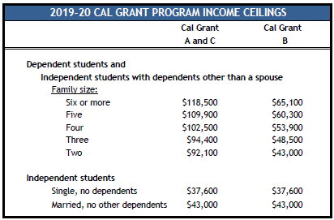
For New & Renewal Cal Grant Recipients
Mar. 2nd
Deadline!
Students track their award @ www.webgrants4students.org

Slide 8
State Aid- Middle Class Scholarship
For new, continuing and transfer undergraduates
Attend/plan to attend a UC or CSU campus
Be a U.S. citizen, permanent resident or AB540 status
Maintain 2.0 GPA
Family incomes up to $171, 000
Now fully implemented, the maximum award will be 40% of mandatory system-wide tuition & fees at a UC or CSU
Apply by either completing the FAFSA or Cal Dream Act Application

Slide 9
Fee & Tuition Waivers
Community College – California College Promise Grant*
*Formerly Board of Governor’s Fee Waiver (BOG)
Waives enrollment fees, FAFSA may be required
www.icanaffordcollege.com
CSU State University Grant (SUG)
Amounts vary, FAFSA is required
www.calstate.edu or csumentor.edu
UC Grant Blue & Gold Plan
Amounts and application process vary
www.universityofcalifornia.edu
Independent College Grants
Amounts and application process vary
www.aiccu.edu or www.aiccumentor.org

Slide 10
Financial Aid for Specific Populations
Middle Class Scholarship: www.csac.ca.gov
Foster Youth: Chafee Grant ~ up to $5000 www.chafee.csac.ca.gov
Athletes: www.ncaaclearinghouse.net
Students with dependents: EOP&S/CARE and CalWORKs
Students with disabilities: www.heath.gwu.edu
Military and their dependents: www.gibill.va.gov
AB540 Students: California Dream Act www.caldreamact.org
Early Childhood Education/Child Development: www.csac.ca.gov
Teachers: Cal Grant A & B Extended Benefits: www.calgrants.org
in addition to grants, Loan Forgiveness: www.teachforamerica.org
Health Occupations-Scholarships & Loan Repayment:
www.healthprofessions.ca.gov

Slide 11
Types of Financial Aid – Gift Aid
Institutional and Private Grants & Scholarships*
Provider decides on
Awarding criteria
Application deadline
Forms or applications
Awards may be
Merit-based (academic performance-GPA)
Need-based (financial need)
Combination of the two
Providers may be: HS, college, employers, credit union, insurance co. (Foresters), service-based orgs. (Kiwanis)
*Apply during same timeline as other financial aid

Slide 12
General Eligibility Criteria
Status
U.S citizen, permanent resident or meet AB540 criteria
For FAFSA, Permanent SS# (Parents do not need a SS#)
For CalDreamAct, no SS# is required for student or parent
Males between ages 18-25 registered for Selective Service
Received HS Diploma or equivalent: GED, CHSPE,
Homeschooled
Enrollment
BOG Fee Waiver & Pell Grant will pay as low as ½ unit
FSEOG, FWS, DL, Chafee & Cal Grants require at least
halftime status
EOP/EOP&S requires full time status (with exceptions)
Must be enrolled in an eligible program of study

Slide 13
FAFSA on the Web’s Homepage
www.fafsa.gov
Notes:
Be sure to go to the correct website as noted, otherwise you may go to a similar site and be charged to complete what is to be a ‘free’ application for federal student aid, hence the name FAFSA. There are many convenient features built into the application, like smart logic and the IRS Retrieval Tool as well as the ability to go in and make corrections to an already submitted application. Students and Parents may estimate their previous year income & submit the FAFSA to meet any school or state deadlines for preliminary awarding. However, a correction to the FAFSA must be submitted once taxes have been filed and processed by the IRS. This can be easily done by using the IRS Data Retrieval Tool. Corrections to income & assets can effect a student’s final award offer. Any school that participates in federal Title IV funding will require the completion of the FAFSA. Schools will download the FAFSA results that the student listed on the application.

Slide 14
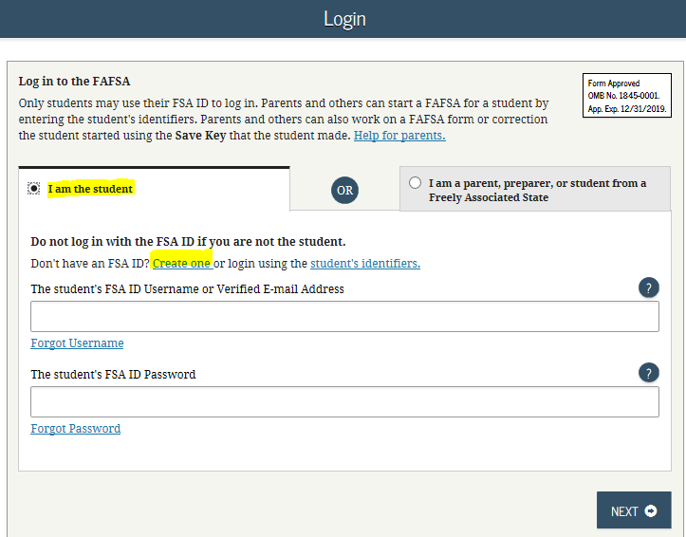
FSA ID

Slide 15
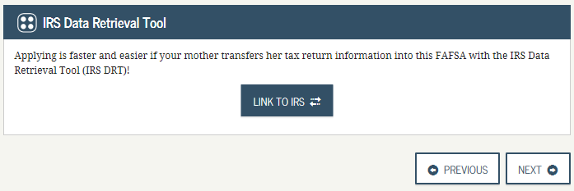
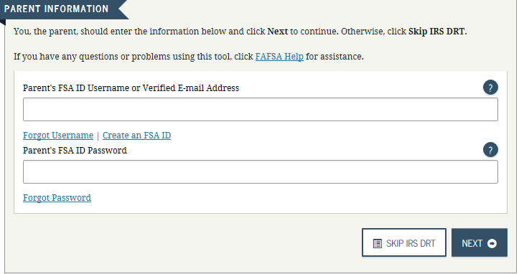
FSA ID
Parents will create FSAID either to transfer IRS
data or at the end for signature

Slide 16
Questions About Assets
Net worth means current market value minus debt. If net worth is negative, enter ‘0’

Slide 17
California Dream Act
www.caldreamact.org

Slide 18
CSS Financial Aid PROFILE https://student.collegeboard.org/css-financial-aid-profile
Student Guide
No paper registration form
On-demand webinar
3 step process
$25 initial application & one college report
$16/add’l college
Note: CA public colleges do not require (UC, CSU, CC); Private colleges may require – check their FA webpage

Slide 19
Dependency Status

Slide 20
Dependency Status –FAFSA/CDA
If students are NOT able to check any of the boxes below, parents income and asset information will be required to complete the FAFSA process.
“Parent” includes: Step (married); adoptive; both biological living together but not married; ‘custodial’ parent if separated or divorced

Slide 21
Calculating Financial Aid Eligibility
 Basic Equation of Need (Eligibility)
The financial aid application is trying to determine your family’s financial strength & ability to contribute to your education, your EFC
Cost of Attendance (COA)
Expected Family Contribution (EFC)
= Eligibility for Need-based Aid

Slide 22
Calculating Financial Aid Eligibility
 Cost of Attendance / Allowances
Standard Allowable Costs:
Additional Allowable Costs:
Dependent care
Study-abroad
Disability-related
Employment expenses for
co-op study
Student loan fees
Tuition and fees: | $ 1,380
Room and board: | $ 5,418
Books and supplies: | $ 1,917
Transportation: | $ 1,251
Misc. personal: | $ 3,258
Total standard allowance: $13,320 (based on 18-19 ‘not paying rent’ COA) (18-19 ‘paying rent’ COA $21,681)
Each student will be assigned a COA/budget based on housing plan: with parent/relatives; on campus; off campus. Tuition is what the biggest difference among colleges will be.

Slide 23
Santa Clara
COA $61,333
- EFC 4,000
= Need $57,333
San Jose State
COA $17,931
- EFC 4,000
= Need $13,931
Mission/WVC
COA $13,320
- EFC 4,000
= Need $ 9,320

Slide 24
Special Circumstances
Adjustments may be made to information on a case-by-case basis
Special circumstances may include changes to
Dependency status
Marital Status (Parent/student separates/divorces)
Income and assets
Child support
Number in household or college
Private elementary/secondary tuition
Medical or dental expenses (not covered by
insurance)
After initial filing up through current AY

Slide 25
Timeline of Financial Aid
Application Forms
FAFSA or Cal Dream Act Application
October 1st ~ Priority Deadline: March 2nd
CSS Profile opens Oct. 1st, deadline set by university
Cal Grant GPA Verification
By March 2nd of the senior year & 1 year after
All HS & Colleges will send GPA electronically
Colleges will not send until 16 units completed
Establish Webgrants4students.org account to track
state awards
Scholarships = usually 1st quarter of new year

Slide 26
Applying for Aid
When applying to an institution, a student should ask the following:
What forms does the institution require?
In addition to the FAFSA, does the school require the completion of an institutional form?
For example, CSS Profile
Verification documentation
What are the filing deadlines for each form?
What type of deadline? (Hard or soft)
Will I still be eligible if I miss it?
Notes:
Always ask questions. Be the ‘squeaky wheel’. Understand that missing a deadline can jeopardize a student receiving an award.

Slide 27
What to take away from this
There is no magic potion for eligibility
The applications are self-certifying but follow-up documentation may be requested
There is a type of financial aid for every student
Apply, apply, APPLY!
Even if you think scholarships will be the only aid, you should still complete the FAFSA - most scholarship applications will ask if you have
Consider ALL college system options, including private & CCs
Colleges will no longer be able to see other colleges listed on FAFSA; for optimum Cal Grant consideration, listing UCs first, then CSUs, then private/out of state, then community colleges should provide the highest award potential
There are Lifetime Eligibility Usage (LEU) limits for Pell Grant & Cal Grants; while we encourage students to explore career options, they need to be focused by the time they reach college or they could run out of grant funding before they complete their first Bachelor’s degree
Gift-aid (grants, scholarships) is available up through undergraduate study, typically first Bachelor’s degree OR LEU, whichever comes first
There is financial aid for graduate students like Federal Work Study, Direct Loans, some fellowship grants & scholarships

Slide 28
That’s It!
Thank you!
Questions?

