Slide 1
University Preparatory Academy Senior Counseling Night August 30, 2016
Counselor – Sandy Trotch
Advisers: Arianna Rodriguez, Kristin Tillim, and Sandy Trotch

Slide 2
Meeting Handouts
Presentation notes
Senior timeline

Slide 3
UPA College Planning Resources
Academic counseling meetings
Individual counseling meetings
Advisory class
Naviance
My Road
Teachers and Staff
Parents, family, friends
Alumni
College visits
College fairs
Virtual tours
Senior year timeline

Slide 4
Pre-Application to College
Senior Year timeline
Graduation requirements
Rigor of classes
AP Courses
Standardized tests
Letters of Recommendations
Personal Statements
Senior Project
Brag Sheet
Activities
Community Service
Internships
Leadership Roles
Athletics
School Recommendations
GPA – what counts

Slide 5
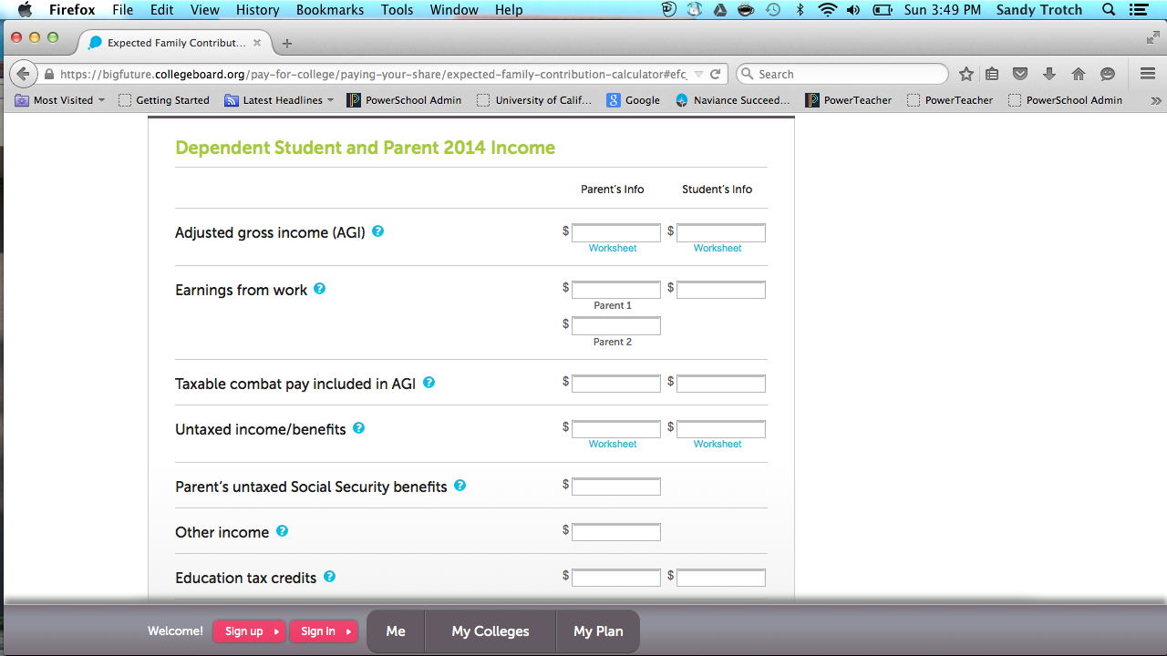
Money may be an Issue: Research Colleges that Give More Aid
EFC and COA
Net Price Calculators
Test optional schools
Colleges that Change Lives
FAFSA prior-prior year starting October

Slide 6
Money and College Board

Slide 7
More Money
No Loan Colleges
Notes:
Ivy leagues included but relates to amount of aid awarded if students do not qualify for Pell Grant

Slide 8
More Money
Common Data Set
Notes:
Cornell University

Slide 9
More Money
COLLEGEdata
Notes:
San Jose State 4 year graduation rate low about 20%

Slide 10
More Money
College Navigator
Notes:
Northern Arizona University

Slide 11
More Money
College Navigator - 2

Slide 12
More Money
College Results
Notes:
Comparison to UCSD

Slide 13
Application to College 2016-2017
Impacted programs Coalition
Impacted campuses Early Decision Binding and nonbinding
California State University admissions
University of California admissions
Private schools FAFSA prior-prior year
Out-of-state schools Personal statements
Declaration of major

Slide 14
Applications canceled
Senioritis
Grades below C
Timelines not met
Request for additional information not completed
Inaccurate or missing information on application
Final transcript not sent
Not checking emails/inappropriate email address
No housing
Not going to mandated summer school at CSU
Below a 3.00 for senior year classes

Slide 15
More Paying for College
Net price calculators
Scholarships given by universities
Scholarships from businesses
Naviance
Ed Fund
Fast Web
Cal Grant
FAFSA
ScholarPRO
Petersons
CollegeBoard

Slide 16
Managing Expectations
Acceptance Rates
Median test scores
Eligibility Index
Grade point average
Difficulty ranking
Percent receiving financial aid
4-year graduation rate
Level of student debt at graduation

Slide 17
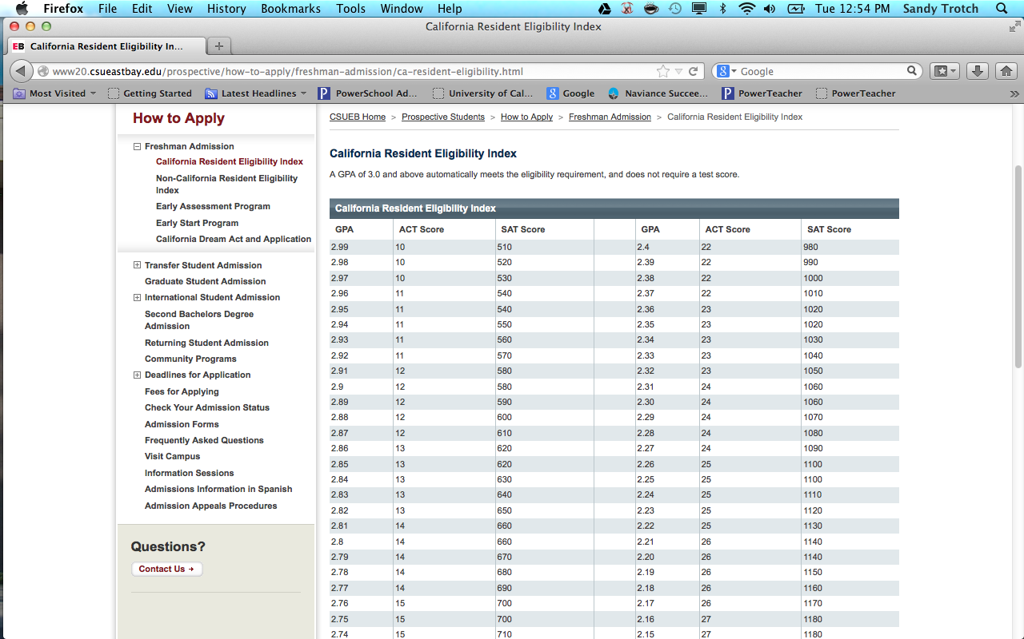

Slide 18
Costs of Senior Year
Tests
Applications
Senior Portraits
Senior shirt
Senior retreat
Cap and Gown
Senior trip
Travel expenses to visit campuses
Graduation
Prom
Senior project
Yearbook
Submitting test scores
Payment to university

Slide 19
Senior Issues
Grades, grades, grades
Meeting graduation requirements
Senior project
Yearbook
College decision making
Stress
Testing completed
Signing up for orientation/college testing

Slide 20
Final thoughts – Keys to Senior Year
Graduation – distraction free, focus on academics to the end
Decide before May 1 – college visits, virtual tours, family discussions, counseling discussions
Prepare – testing, application needs, registration, time , plan before deadlines
Pay – Financial aid and scholarship applications
Ask – Use Naviance to send messages to teachers and counselors
Talk – Have the college conversation and the financial conversation
Manage – manage expectations – the right school is out there for you

